Slide 1
Hacking with React
http://www.hackingwithreact.com/
Notes:
Mitrais CDC React, delivered on 11/25/2016 by Havit Choirul Rovik

Slide 2
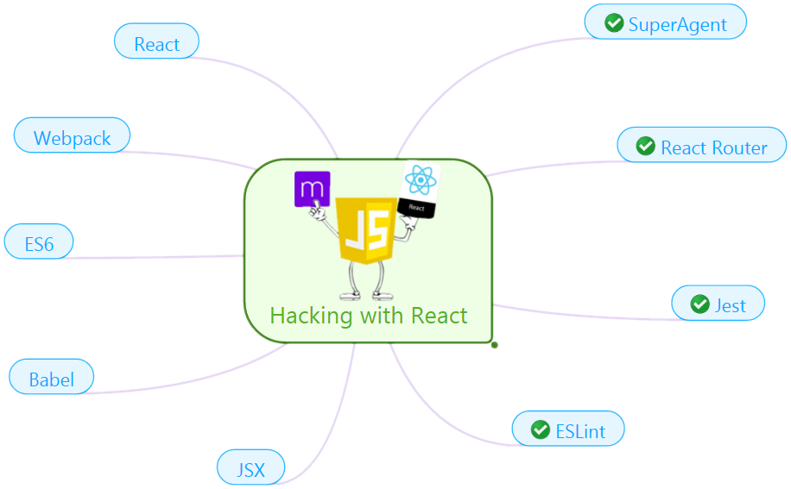
What will I learn?
Notes:
This part 1 presentation only covers:
SuperAgent : a small progressive client-side HTTP request library https://github.com/visionmedia/superagent
React Router : a complete routing library for React https://github.com/ReactTraining/react-router
The rest will be in part 2 ->
Jest : a JavaScript testing framework https://facebook.github.io/jest/
ESLint : a pluggable linting utility for JavaScript and JSX http://eslint.org/

Slide 3
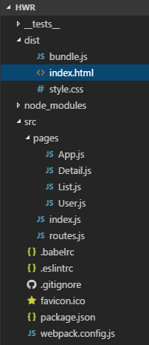
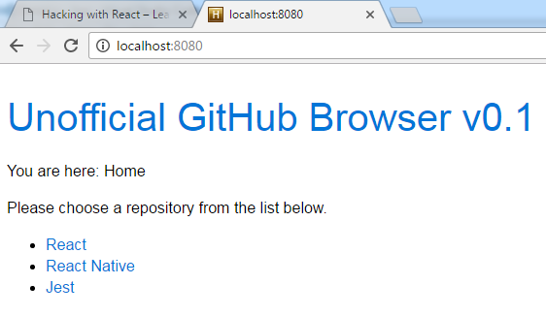

The Project
Notes:
Open VS Code
Goes through each folder
__tests__ folder will be explained later, on part 2

Slide 4

{}
Notes:
Open VS Code
Open hackingwithreact project
Open terminal Ctrl + `
webpack-dev-server Enter
Open http://localhost:8080/
Make sure to open React Developer Tools
It fetches data from GitHub API

Slide 5

Hacking with React
SuperAgent
React Router
Jest
ESLint
Notes:
the agenda~

Slide 6

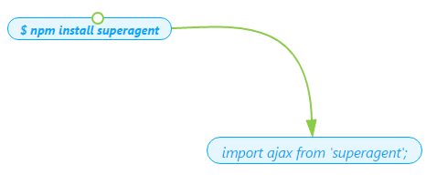
SuperAgent
A light-weight progressive ajax API crafted for flexibility, readability, and a low learning curve after being frustrated with many of the existing request APIs.
docs: http://visionmedia.github.io/superagent/
Notes:
This application uses SuperAgent v2.3.0.
SuperAgent supports common HTTP calls: GET, DELETE, POST, PUT, etc. Please refer to its documentation, http://visionmedia.github.io/superagent/

Slide 7
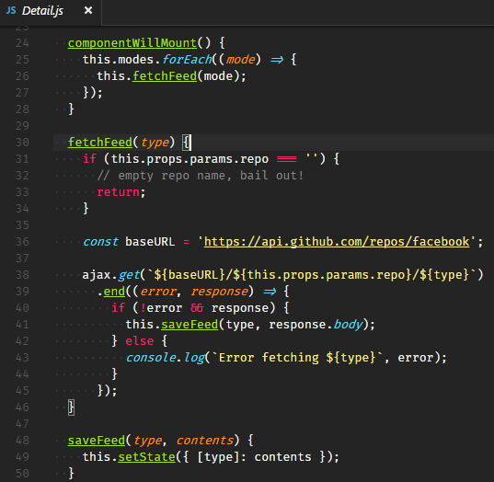
SuperAgent – Detail.js
Notes:
The syntax is straightforward. When mount the component, it loops through the mode, which is: commits, forks and pulls.
Let's break down what it actually does…
componentWillMount() is the name of the method, and needs to be named exactly this in order for React to call it.
ajax.get('https://api.github.com/repos/facebook/react/commits') tells SuperAgent to fetch the list of commits to the React project from GitHub. I chose GitHub because they have a simple API that doesn't require authentication.
.end((error, response) => { tells SuperAgent what to do when the request finishes: it should run the anonymous function that follows.
if (!error && response) { starts a conditional statement: the following should run only if there was no error and there was a response from the server.
this.saveFeed(type, response.body) updates our component's state using the body value of the SuperAgent response.
} else { the other half of our conditional statement: if there was an error or if the server provided no response.
console.log(...) print an error message to the browser console window.

Slide 8
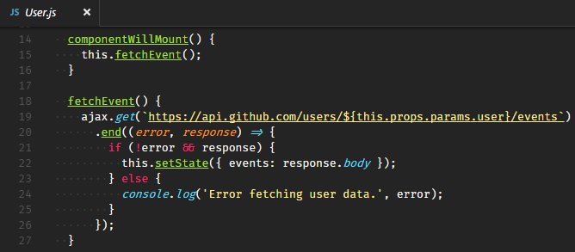
SuperAgent – User.js
Notes:
The second use is in User.
First: all SuperAgent calls are asynchronous, which means your code doesn't just freeze while SuperAgent waits for GitHub to respond. Instead, other code executes, and SuperAgent will only call your anonymous function when it has finished getting GitHub's response.
The second thing to know is that response.body is a bit of SuperAgent magic: it has detected that GitHub has responded with the content type "application/json" and automatically converts GitHub's response into JavaScript objects. That's why we can send response.body straight into our state: it's already an array of objects ready to use.
Let’s see the demo.
Open http://localhost:8080/
Developer tools – Network
Try react, there will be: commits, forks and pulls
Try to click the username, there will be events
If you try the tutorial and get errors 403 forbidden, see this: https://developer.github.com/v3/#rate-limiting

Slide 9

Hacking with React
SuperAgent
React Router
Jest
ESLint
Notes:
the agenda~

Slide 10

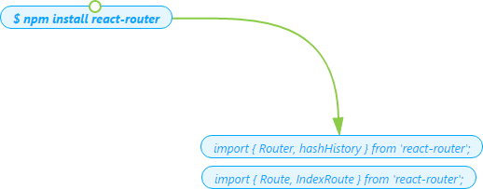
React Router
A component that loads different pages depending on the URL your user asked for.
docs: https://github.com/ReactTraining/react-router
Notes:
This application uses React Router v3.0.0.
It’s a complete routing library for React
It keeps your UI in sync with the URL
It has a simple API with powerful features like lazy code loading, dynamic route matching, and location transition handling built right in
Tips create multiple file:
Delete webpack, babelrc
touch .babelrc webpack.config.js

Slide 11
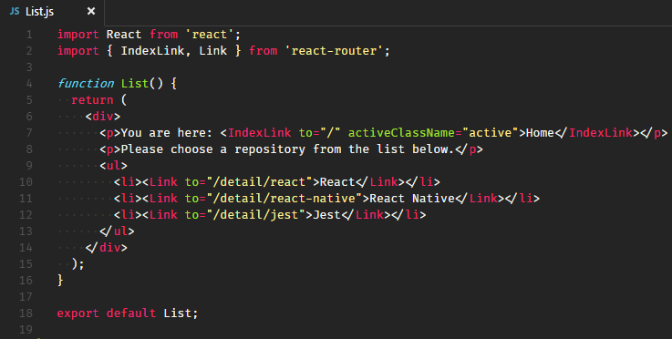
React Router – List.js
Notes:
What is <Link> ?
<Link> is similar to using an html anchor tag. By using <Link> , it allow users to navigate around your application.
<Link> will render a fully accessible anchor tag with the proper href.
And <IndexLink> ?
If you were to <Link to="/">Home</Link> in this app, it would always be active since every URL starts with /. This is a problem because we'd like to link to Home but only be active if Home is rendered.
To have a link to / that is only active when the Home route is rendered, use <IndexLink to="/">Home</IndexLink>.
Let’s see the demo. | Notice that
Open http://localhost:8080/ Home is active (with black color)
Click React Home is inactive (now it has blue color)
Try to edit the code. Open Detail, User and List. Change IndexLink to Link and see how it goes.

Slide 12
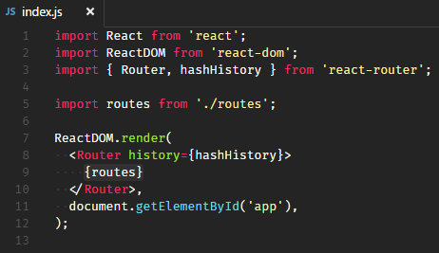
React Router – index.js
hashHistory? uses the hash (#) portion of the URL,
creating routes that look like example.com/#/some/path
Notes:
On this file, we import Router and hashHistory components from the react-router.
Router: wrap all of the routes we define in ./routes
From react router, there is hashHistory and browserHistory. We will talk about it later.
`Great tutorial for beginner to understand React Router
: https://medium.com/@dabit3/beginner-s-guide-to-react-router-53094349669

Slide 13
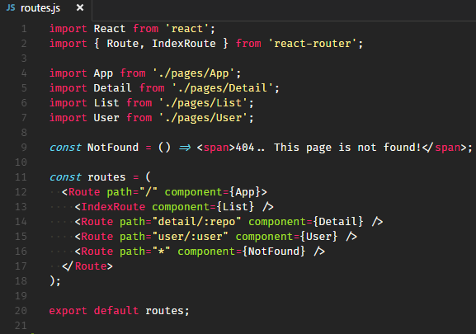
React Router – routes.js
Notes:
Let’s dive more deeper. Routes here is the component that will replace routes in the index.js
React Router knows how to build nested UI for us, so we don't have to manually figure out which <Child> component to render.
For example, for a full path /detail it would build <App><Detail /></App>.
We are also setting List to be our IndexRoute. That means that when we hit http://localhost:8080, our List component will render, as it is specified as the index.
Let’s see the demo. | Notice that the URL is
Open http://localhost:8080/ http://localhost:8080/#/
Click React http://localhost:8080/#/detail/react
Click User http://localhost:8080/#/user/spicyj
Type wrong URL? 404.. This page is not found!

Slide 14

Histories
React Router is built with history.
browserHistory | hashHistory
uses the History API built into the browser to manipulate the URL | uses the hash (#) portion of the URL
creating real URLs | creating routes
example.com/some/path | example.com/#/some/path
Production web applications
Notes:
In a nutshell, a history knows how to listen to the browser's address bar for changes and parses the URL into a location object that the router can use to match routes and render the correct set of components.
Browser history is the recommended history for browser application with React Router. It uses the History API built into the browser to manipulate the URL, creating real URLs that look like example.com/some/path.
Hash history works without configuring your server, so if you're just getting started, go ahead and use it. In general, though, production web applications should use browserHistory for the cleaner URLs, and for support for server-side rendering, which is impossible with hashHistory.
Let’s see the demo. Try to change hashHistory with browserHistory.
Change index.html, index.js and webpack.config.js as you can see here: https://github.com/mitrais-cdc-js/hacking-with-react/commit/4c959bdaa7d533e3890cdbcb21a170855dc7a64c
For more, please refer to the docs:
https://github.com/ReactTraining/react-router/blob/master/docs/guides/Histories.md#browserhistory
https://github.com/ReactTraining/react-router/blob/master/docs/guides/Histories.md#hashhistory
About History:
https://developer.mozilla.org/en-US/docs/Web/API/History

Slide 15

Hacking with React
SuperAgent
React Router
Jest
ESLint
Notes:
the agenda~

